Slide 1

IBM capstone project
Battle of the neighborhoods – Singapore
Teoh Jeng Wei

Slide 2
Content
Background
Problem Statement
Result & Discussion
Methodology
Conclusion

Slide 3
East vs west - Background
For years, Singaporeans have always been debated over this topic of whether the East region or the West region of Singapore is the better one to live in.
Debate over attributes of the neighbourhoods in the East and West regions of Singapore:
Variety of food options
Variety of amenities
Accessibility to key points of interest

Slide 4
Problem statement
Which region is the better region in Singapore to live in? Is it the East region or the West region?
For someone who is looking to purchase and move into a new home in Singapore, can we recommend a region for him/her based on his/her personal preferences?

Slide 5
methodology
Data Collection
Data Cleaning and Manipulation
Model Selection and Training
Results
Name, coordinates and area of the neighborhoods in the West and East regions of Singapore (to be obtained via web scrapping)
Name and categories of venues in each of the neighborhoods (to be obtained using Fourquare API)
Neighbourhoods with small or missing population values should be removed from analysis
One hot encode venue data (as it is categorical data)
Group the venues based on the neighbourhood to create dataset for model training
Clustering algorithm should be used as dataset is not labelled and we want to group neighborhoods based on the extent of similiarity between them.
Algorithm selected is k-means clustering. Number of clusters is determined based on intermediate results
Visualization of clusters
Description of each cluster

Slide 6
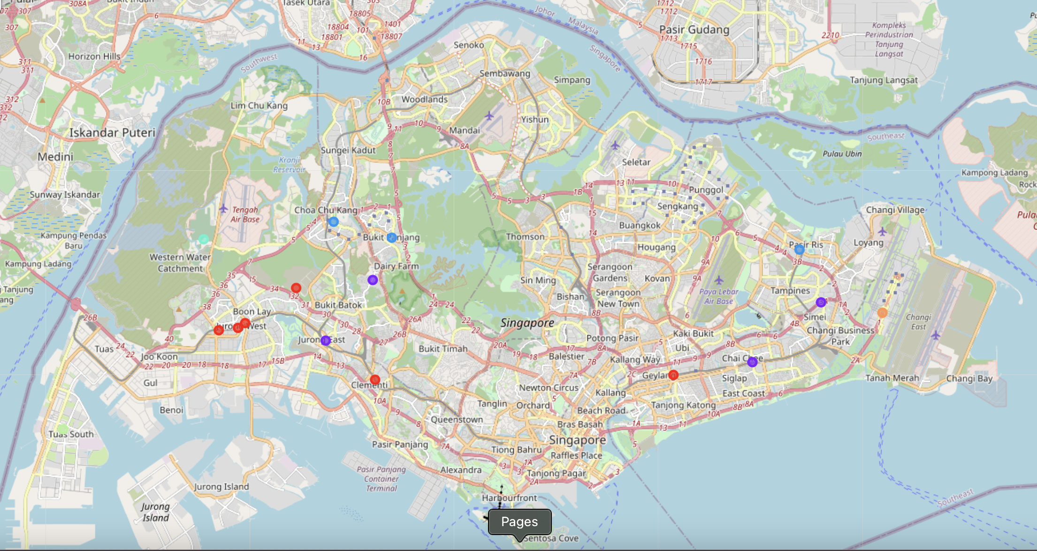
Visualization OF Neighborhood Clusters
Cluster 0
Cluster 1
Cluster 2
Cluster 3
Cluster 4
Cluster 5

Slide 7
Looking at the map…
Observation 1
Neighbourhoods in both regions closer to the city (central area) are similar to each other
Observation 2
Neighbourhoods that are on the extreme ends of Singapore are unique in nature

Slide 8
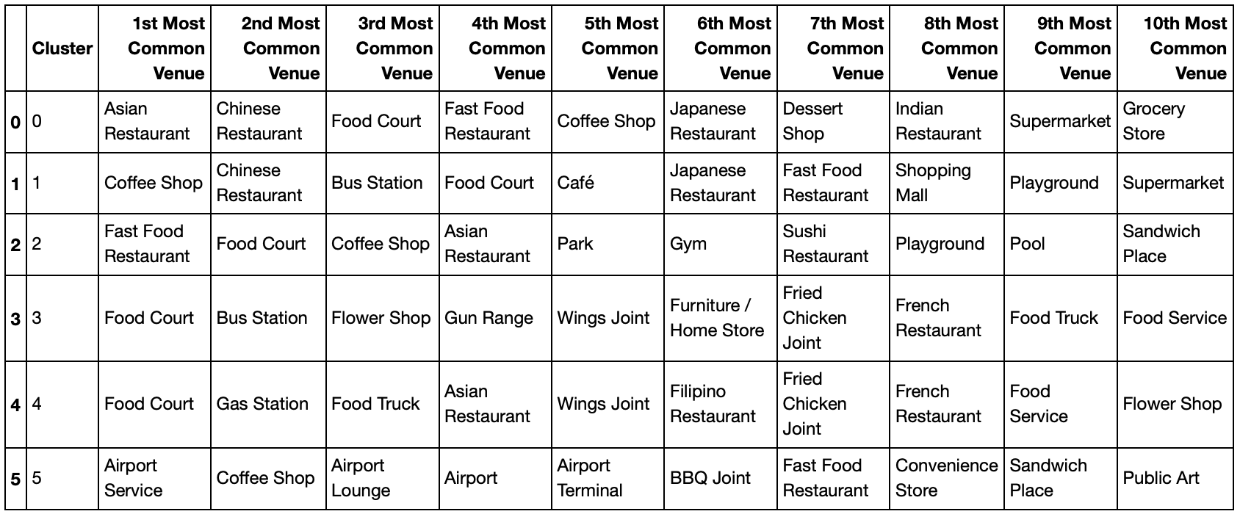
Delving into the clusters

Slide 9
Cluster characteristics
Cluster 0 (Red): Neighborhoods with huge variety of restaurants
Cluster 1 (Purple): Neighborhoods with good bus network accessibility and good variety of restaurants and café
Cluster 2 (Blue): Neighborhoods with a well-balanced profile of food establishments and outdoor facilities
Cluster 3 (Cyan): Neighborhoods with military-related facilities and furniture stores in close proximity, but with limited food options
Cluster 4 (Green): Neighborhoods with cheap food options and great accessibility to gas stations
Cluster 5 (Orange): Neighborhoods with the airport in close proximity

Slide 10
Cluster characteristics
Cluster no. | Description
0 | Huge variety of restaurants
1 | Good bus network accessibility Good variety of restaurants and cafe
2 | Well-balanced profile of food establishments and outdoor facilities
3 | Military-related facilities and furniture stores in close proximity Limited food options
4 | Cheap food options Great accessibility to gas stations
5 | Airport in close proximity

Slide 11
East vs west
EAST | WEST
Great accessibility to restaurants, cafes, outdoor facilities for neighbourhoods nearer to central area | Great accessibility to restaurants, cafes, outdoor facilities for neighbourhoods nearer to central area
Great accessibility to Changi international airport | Poor accessibility to Changi international airport
In close proximity with airport -> noise pollution | In close proximity with industrialised and militarised areas -> higher levels of air pollution and noise pollution

Slide 12
CONCLUSION and future directions
Based on the location data used in this notebook, the East region seems to be the better region to live in.
Within the East region, the choice of neighborhood then depends on one's personal preferences. For example:
Someone who likes cafe-hopping should live in Bedok
Someone who is a frequent flyer should live in Changi
This conclusion is done on a limited dataset containing only location data.
To provide a more holistic analysis, we would need more data such as housing prices, temperature, humidity, google ratings, etc.
This will provide the clustering algorithms with more features to work with, which should give us a fuller picture when answering the problem statement.

Slide 13
Thank you

